Slide 1
Flexbox

Slide 2
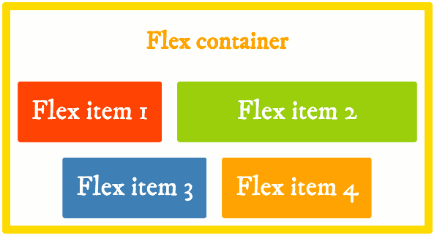
Le module CSS3 Flexbox Layout fournit une façon efficace de disposer, aligner et distribuer l'espace entre les items d'un container, même lorsque leurs dimensions sont inconnues et/ou dynamiques - d'où le terme "flex".
L'idée principale est de donner à un élément contenant (container) la possibilité de changer les largeur et hauteur des éléments contenus (items), afin de remplir au mieux l'espace disponible, et de s'adapter à tous les terminaux et toutes les tailles d'écrans. Un container flexible permet aux items de s'étendre pour occuper la place disponible ou au contraire les réduit pour leur éviter de déborder.

Slide 3
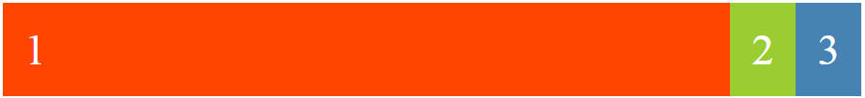
Exemple No.1:Flexible Box (1/3)
declare the outer element as a flex container. That's all we need in order to start using flexbox. Now all of that flex container's in-flow children automatically become flex items and are therefore laid out using the flex layout model.
<!doctype html>
<title>Example</title>
<link rel="stylesheet" href="styles.css">
<div class="container">
<div class="red">1</div>
<div class="green">2</div>
<div class="blue">3</div>
</div>
.container {
display: flex;
}
.red {
background: orangered;
flex-grow: 1;
}
.green {
background: yellowgreen;
}
.blue {
background: steelblue;
}
.container > div {
font-size: 5vw;
padding: .5em;
color: white;
}
sets the flex item's grow factor
(init val =0)
the red flex item is wider than the other two
big wide orange flex item, followed by a small green and a small blue one.

Slide 4
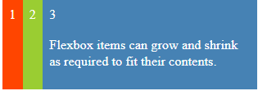
Exemple No.1:Adding Content(2/3)
<!doctype html>
<title>Example</title>
<link rel="stylesheet" href="styles.css">
<div class="container">
<div class="red">1</div>
<div class="green">2</div>
<div class="blue">3<p>Flexbox items can grow and shrink as required to fit their contents.</p></div>
</div>
.container {
display: flex;
}
.red {
background: orangered;
flex-grow: 1;
}
.green {
background: yellowgreen;
}
.blue {
background: steelblue;
}
.container > div {
font-size: 5vw;
padding: .5em;
color: white;
}
add some content to the blue item, and it grew as required in order to fit the new content

Slide 5
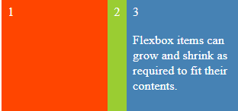
Exemple No.1:Changing the Width(3/3)
<!doctype html>
<title>Example</title>
<link rel="stylesheet" href="styles.css">
<div class="container">
<div class="red">1</div>
<div class="green">2</div>
<div class="blue">3<p>Flexbox items can grow and shrink as required to fit their contents.</p></div>
</div>
.container {
display: flex;
}
.red {
background: orangered;
flex-grow: 1;
}
.green {
background: yellowgreen;
}
.blue {
background: steelblue;
width: 40vw;
}
.container > div {
font-size: 5vw;
padding: .5em;
color: white;
}

Slide 6
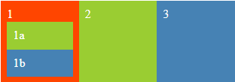
Exemple No. 2 : Nested Flex Containers
<!doctype html>
<title>Example</title>
<div class="container">
<div class="red">1
<div class="green">1a</div>
<div class="blue">1b</div>
</div>
<div class="green">2</div>
<div class="blue">3</div>
</div>
.container {
display: flex;
}
.red {
background: orangered;
display: flex;
flex-direction: column;
}
.green {
background: yellowgreen;
}
.blue {
background: steelblue;
}
.container div {
font-size: 5vw;
padding: .5em;
color: white;
flex: 1;
}
flex items to stack up vertically on top of each other
(By default : row)

Slide 7
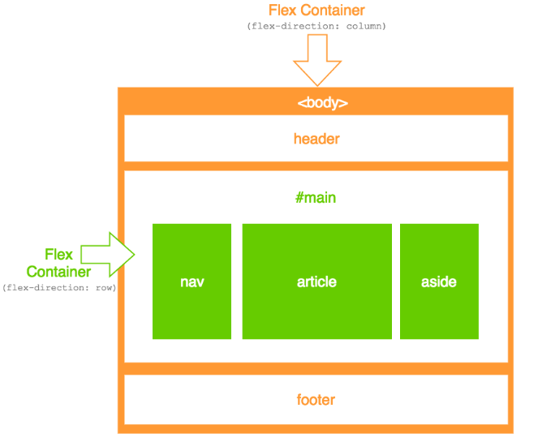
Two Dimensional Website Layouts

Slide 8
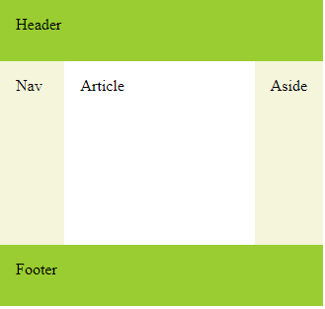
Ex1 : Website Layout with Flexbox

Slide 9
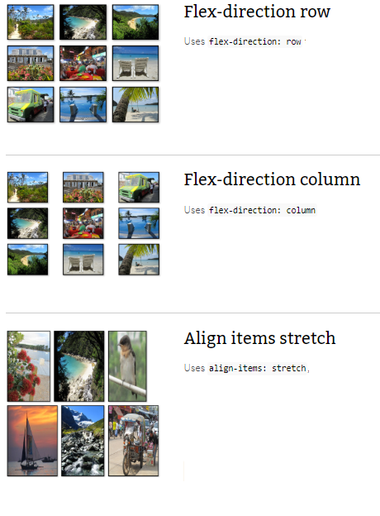
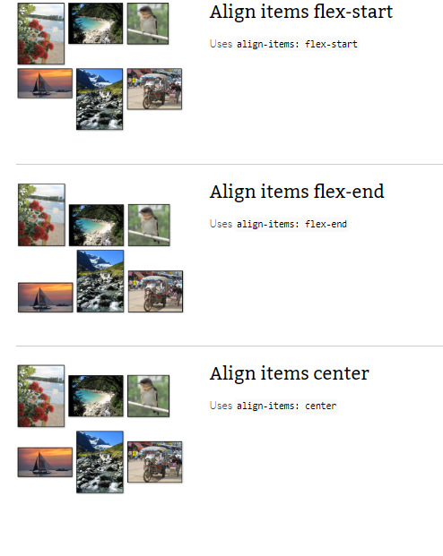
Ex.2 : Integrate Images in your site

Slide 10
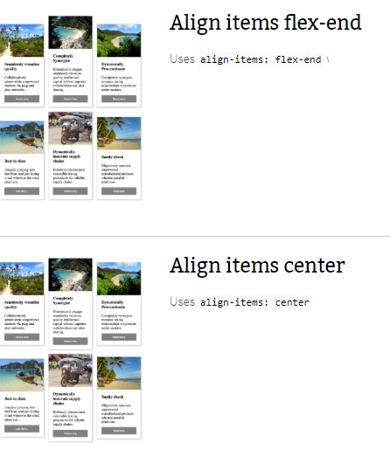
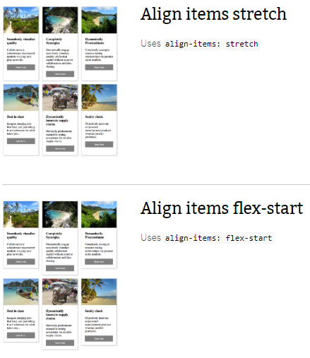
Ex3. Integrate Cards in your site

